Slide 1
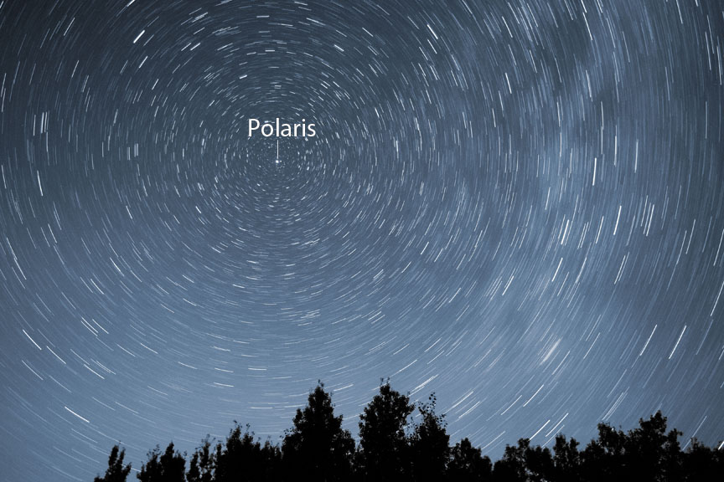
Polaris
Other Names:
The North Star
Lodestar
Navigatoria
Alpha Ursae Minoris

Slide 2
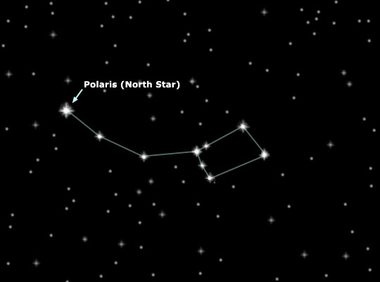
Polaris is a variable double star in Ursa Minor, but there is actually a 3rd spectroscopic companion. It is famous for its location near the celestial pole.

Slide 3
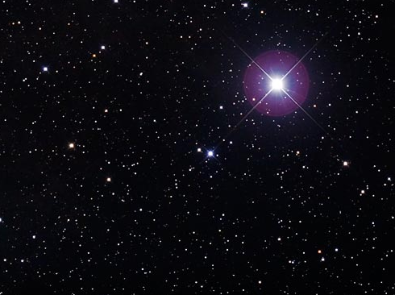
Polaris
430 light years away
Light we’re seeing left in 1587 AD:
1580 - Sir Francis Drake completes his circumnavigation of the globe…his is the 2nd journey to do that and the first under the same commander.
1582 – Shakespeare marries Anne Hathaway
1580s – Chocolate is introduced commercially to Europe
1587 – English settlers arrive at Roanoke Island in North Carolina and re-establish the deserted colony

Slide 4
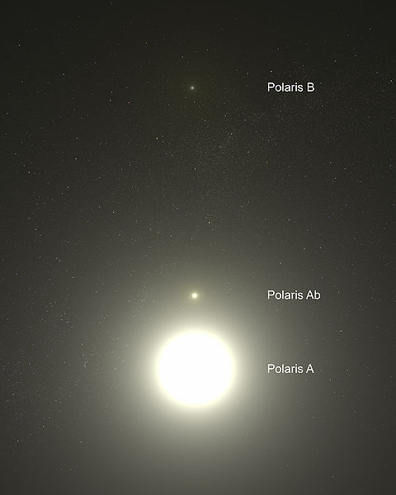
Polaris
Polaris A and Polaris B are at least 2,400 AU apart. They take at least 42,000 years to rotate around each other.
*AU stands for Astronomical Unit. One AU is the distance from the Earth to the Sun.

Slide 5
Polaris
Polaris Ab was discovered in 1929 using spectroscopy. Ab takes 29.6 years to orbit A, at an average distance of 18.5 AU. A very eccentric orbit takes it between 6.7 and 27 AU.

Slide 6
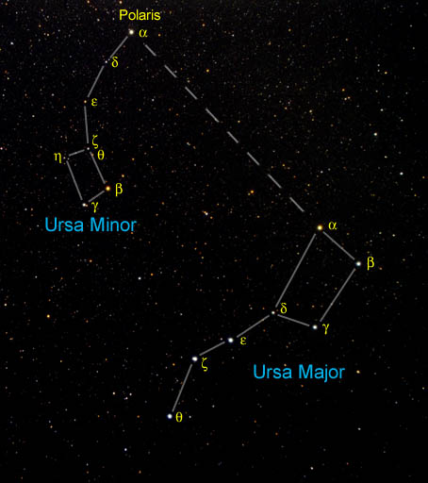

Slide 7
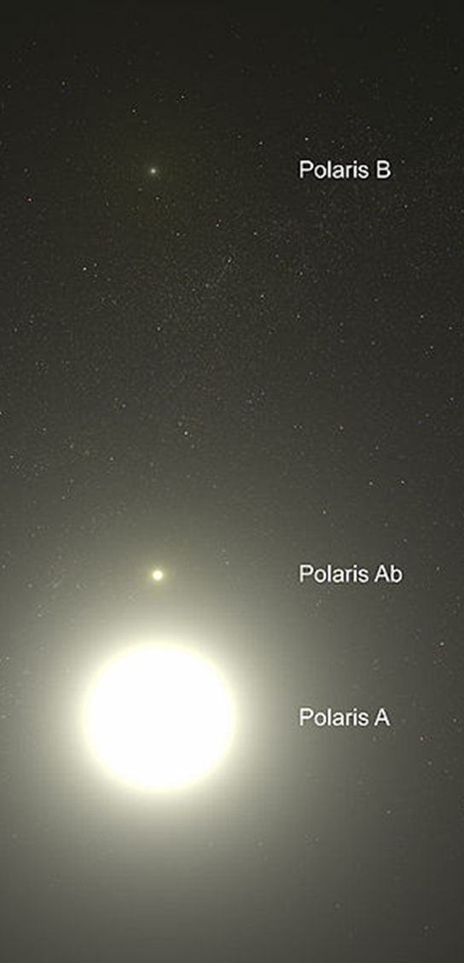
Polaris A
Yellow variable supergiant
B-V Color Index: +0.61 yellow
Luminosity: 2,500 Suns visual
Temperature: 10,340⁰ F
Diameter: 45.6 Suns
Mass: 6 Suns

Slide 8
Polaris A
Yellow variable supergiant
Magnitude Range:
+1.86 to +2.13
Period 3.96 days

Slide 9
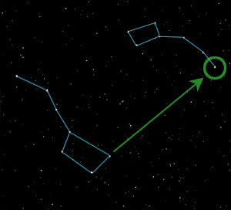

Slide 10
Polaris B
Main sequence, pale white
Luminosity: 28 Suns visual
Mass: 1.4 Suns
Magnitude : +9.1
Discovered by William Herschel in 1780.

Slide 11
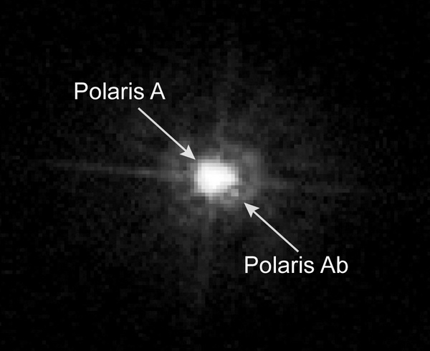

Slide 12
Polaris Ab
Main sequence, dwarf white
Orbits Polaris A
Mass: 1.25 Suns

Slide 13
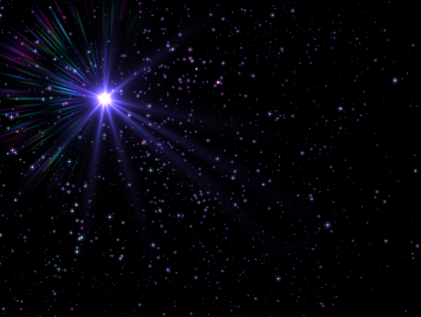
Polaris A
This is a pulsating Cepheid star (the closest one to Earth).
It currently ranges in magnitude from +1.86 to +2.13 over a period of just under 4 days.
Hydrogen fusion in its core has stopped. It is now passing through a phase of pulsating instability.
▪ Polaris’ pulsations have nearly stopped. Around 1900, the luminosity varied 8% from its average, but since then the variation has been declining. The variation reached 1% in the mid-1990s.

Slide 14
Polaris A
This is a pulsating Cepheid star.
Polaris’ pulsations have nearly stopped. Around 1900, the luminosity varied 8% from its average, but since then the variation has been declining. The variation reached 1% in the mid-1990s.

Slide 15
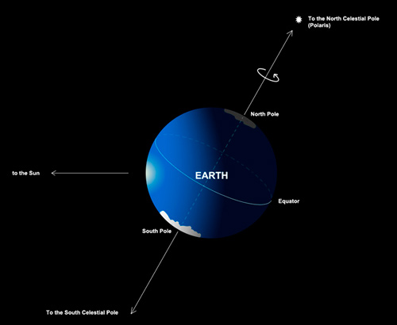
The Pole Star

Slide 16
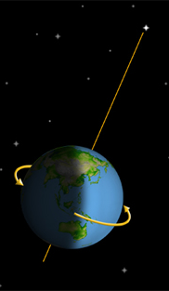
The Pole Star
Today, Polaris is less than 42’ from the true pole and is actually moving closer to it. It will reach a minimum of 27.5’ from true pole in the year 2101 A.D. After that it will begin moving away from true pole.

Slide 17
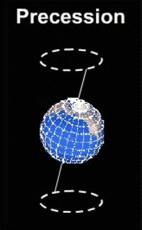
The Pole Star
The change in location relative to the North Pole is due to the slow wobble in the orientation of the Earth’s axis (caused by gravitational effects of the Sun & Moon). This is called precession. The north celestial pole traces out a 47⁰ circle in the sky every 25,800 years.

Slide 18
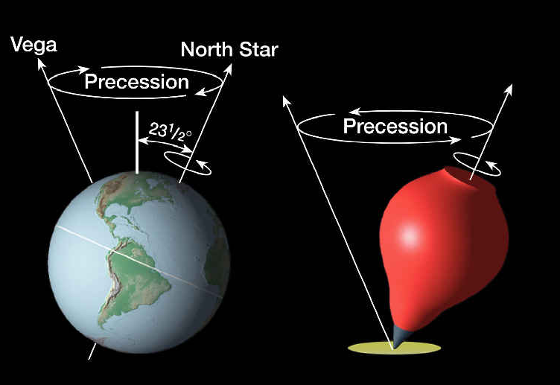
The Pole Star

Slide 19

The Pole Star
Other stars along this circle were the pole star in the past and will be again in the future.
Vega was the pole star about 12,000 years ago.

Slide 20
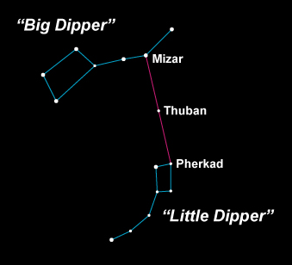
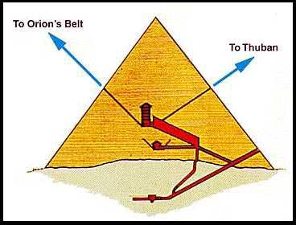
When the Pyramids were built
4,600 years ago,
the star Thuban
was the pole star,
not Polaris.

Slide 21
The Pole Star
At the time of Christopher Columbus, Polaris was 4⁰ away from the pole. He did not need to use it for navigation because the compass had already been invented, but he did check his compass against it.

Slide 22
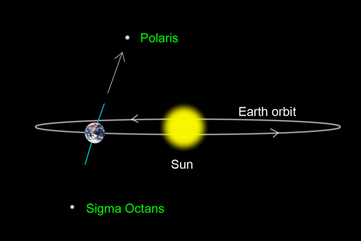
Polaris

Slide 23
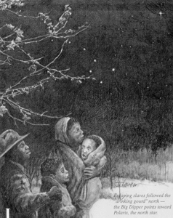

The North Star
In the 1800s, Polaris would guide escaped slaves to freedom.

Slide 24
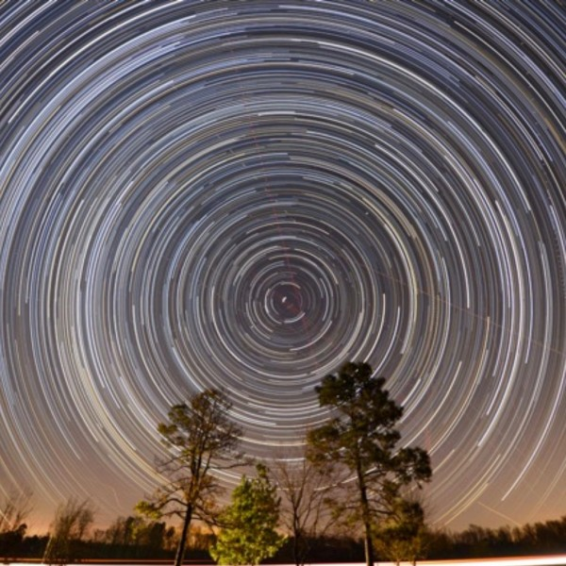
Polaris

Slide 25
Polaris
It is the 48th brightest star in the sky, but is easy to spot because there are relatively few bright stars near it.
It is not visible from the Southern Hemisphere.

